Slide 1
Initiating Research
Academic Writing Course

Slide 2
Contents
1
Definition and types of research
2
Steps to initiate a research
3
Selection of a research topic
4
Formulation of a thesis statement
5
Construction of an effective title
6
Creation of a working outline

Slide 3

What is a research?
Research is a systematic, formal, rigorous and precise process employed to gain solutions to problems or to discover and interpret new facts and relationships. (Waltz and Bausell, 1981).
Research is the pursuit of truth with the help of study, observation, comparison and experiment; the search for knowledge through objective and systematic method of finding solutions to a problem (Kothari, 2006).
Research is the systematic activity directed towards objectively investigating specific problems in order to discover the relationships between and among variables. It seeks to answer specific questions. (Nyanjui, 2010)

Slide 4
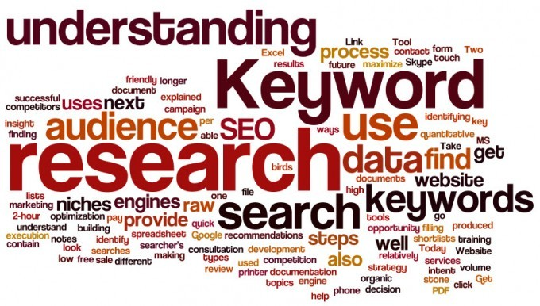
P12
Three Ps to describe the whole process of research?
Purpose
Process
Product
(Questions/Problems)
(Systematic Approach)
(Answers/Solutions)

Slide 5

Types of research?
Discussion
Perspective | Type of Research
the purpose of the research
the nature of the dominant data
the way of the research
the type of analysis
theoretical/basic research
applied research
qualitative research
quantitative research
primary research
secondary research
descriptive research
analytical research

Slide 6
increasing scientific knowledge
using basic research to solve problems or develop new processes, products, or techniques
Point of View | research
the purpose of the research | basic research
 | applied research
the nature of the dominant data | qualitative research
 | quantitative research
the way of the research | primary research
 | secondary research
the type of analysis | descriptive research
 | analytical research
field research
survey- or experiment-based research
library- or Internet-based research
desk research

Slide 7



P12-14
Steps to initiate a research?
Steps | Key Information
Step 1
Step 2
Step 3
Step 4
interesting
specific, unique and significant
Selecting a topic
answer to the research question
the purpose of research
specific
Formulating a thesis statement
the fewest possible words
focus and purpose of research
phrase, incomplete sentence
Constructing a title
enhance organization and coherence of research paper
serve the purpose well
topic or sentence outline
Creating an outline

Slide 8
Principles of topic selection?
interesting
a topic that interests you and your readers
important
a topic that has practical or theoretical value
manageable
a topic that you are able to reasonably conduct
a topic that is not too specific or too general
adequate
a topic that has adequate source materials available

Slide 9

Methods for selecting a topic?
Discussion
Consult your professor or an expert
Participate in academic conference and academic lectures
Select from puzzling problems
Read books and newspapers
Choose from your own interests
Do literature reviews

Slide 10
What is a thesis statement?
is a statement that you plans to support, discuss or prove.
makes a claim that others might dispute.
identifies the specific objectives your research or your paper will address.
determines the size of your research or the length of you paper.
tells the reader how you will interpret the significance of the subject matter under discussion.
tells the reader what to expect from the rest of the paper. It is a road map for the paper.
is a statement somewhere in the first paragraph that presents your argument to the reader.

Slide 11
How to formulate a research question?
Brainstorm and Settle on a topic
Narrow down the topic
Take a position on the topic by asking a question about the topic and answering the question
Conduct more research and tinker with your thesis statement until you are satisfied with it

Slide 12
You Focus on the problems posed by the changes in the dietary habits of Americans
Because half of all American elementary school children consume nine times the recommended daily allowance of sugar, schools should be required to replace the beverages in soda machines with healthy alternatives.
You find that you’re interested in the amount of sugar Americans consume
Sugar consumption
More attention should be paid to the food and beverage choices available to elementary school children
Reducing sugar consumption by elementary school children

Slide 13

Features of a good title?
It should be concise and specific.
It arouses the reader's interest.
It facilitates online information retrieval as it contains keywords.
It predicts content.
The degeneration of neurons in the CA3 and DG following OA administration: involvement of a MAPK-dependent pathway in regional-specific neuronal degeneration
Region-specific neuronal degeneration after okadaic acid administration
MAP kinase-dependent neuronal degeneration after okadaic acid administration
Notes:
This title is too long, contains non-standard abbreviations and a redundancy, and is too specific in parts. Further, many journals do not want titles that begin with the, a, or an.

Slide 14
Principles of title selection?
Value principle
Does it play a catalytic role in social development and scientific progress?
Does it add to human knowledge?
Does it contribute to the academic growth of the researcher?
Scientific principle
Scientific methods must be applied in conducting research, interpreting findings, and drawing conclusions.

Slide 15
Innovative principle
Innovation is the soul of scientific research, which is reflected in the novelty and uniqueness in selection of the title, research methods, research perspective and the results.
Is the title in the forefront of research and development?
Is the research perspective novel?
Are there any new discoveries or new ideas?
Are the research methods unique?
Feasibility principle
Are the readers interested in the topics?
Are the materials adequate?
Are the conditions for research and investigation conducive?
Do time and economic conditions allow?

Slide 16
Format of a typical title?
a title
method
content
influence
Type of paper
comparison
analysis
contrast
discussion
evaluation
study
causes
effects
advantages
benefits
effectiveness
etc.
a typical title:
key words of the method
+
key words of the content
+
subject matter
An analysis of Psychological Motivation of Computer Hackers
The Comparison of the Effectiveness of Two Approaches to Lung Cancer
The Analysis of Environmental Effects of Nuclear Power Plants

Slide 17
How to formulate a Title
general
City Development
Sustainable Development of Cities
Sustainable Development of Big Cities
Sustainable Development of Chinese Big Cities
Sustainable Development of Chinese Big Cities from the Biological Perspective
specific

Slide 18
Types of title?
Declarative titles —state the main findings or conclusions
e.g. A three-month weight loss program increases self-esteem in adolescent girls
Descriptive titles —describe the subject of the article but do not reveal the main conclusions
e.g. The effects of family support on patients with dementia
Interrogative titles —introduce the subject in the form of a question
e.g. Does cognitive training improve performance on pattern recognition tasks?

Slide 19
Linguistic Features of Title
Use more nouns, noun phrases and gerunds
The words or phrases used in a title are very often nouns, noun phrases or gerunds. Nominalization has the ability to sum up the whole paper.
Use an incomplete sentence
A title is just a label or appellation of the paper, reflecting the main idea of the contents. It does not need to be a complete sentence.
Omissions of certain words
Articles (a, an, the), and adjective pronouns (his, my, etc.)

Slide 20
Capitalization in a title?
Capitalize all the letters
eg. GROWTH MECHANISM OF WHISKERS AND TREATMENT FOR DEFECT
Capitalize the initial letter of the first word and that of a proper noun(专有名词)
eg. Research on the flow and sediment transport of Dujiangyan Project
Capitalize the initial letter of the first word, content words and those of conjunctions (连词) and prepositions (介词) of 5 letters or more
eg. Growth Mechanism of Whiskers and Treatment for Defect Removal

Slide 21
Tips on formulating a title?
Use the fewest possible words that accurately describe the content of the paper (the recommended length is no more than 12 words)
Use phrases or incomplete sentences
Express only one idea or subject in the title
Put an important word first in the title
Eliminate redundant words such as verbs and articles
Omit all waste words such as "A study of ...", "Investigations of ...", "Observations on ... “
Avoid using abbreviations and acronyms

Slide 22
Translation practice
土壤的物理特性与作物产量的关系
利用植物清除土壤中的重金属
网络环境下的信息素质教育
三峡水电站自动发电控制的研究
构建具有中国特色的英语教学“一条龙”体系
科研论文标题英译的简约与冗余
现代信息工具在科技英语翻译中的应用
Relationship Between Soil Physical Properties and Crop Production
Removal of Heavy Metals from Soil with Plants
Information Quality Education under Network Circumstances
AGC(Automatic Generation Control) in Three Gorges Hydropower Plant
Construction of Streamline ELT System in China
Brevity and Redundancy in Translating Headlines of Research Papers
Application of Modem Information Tools in Translating Technical English

Slide 23
Reasons for creating a working outline?
Aids in the process of writing
Helps you organize your ideas
Presents your material in a logical form
Shows the relationships among ideas in your writing
Constructs an ordered overview of your writing
Defines boundaries and groups

Slide 24
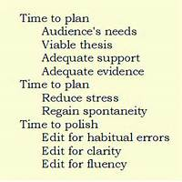
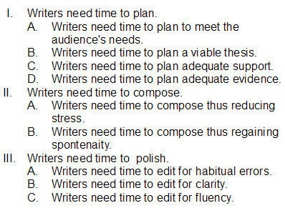
Types of outline?
Topic Outline
Sentence Outline
Parallelism
Coordination
Subordination
Division

Slide 25
Academic Writing Course
Thank You !

